Slide 1
GIT
CS 441, Spring 2020, Yongjie Zheng

Slide 2
GIT
Overview
  GIT Basics
  Highlights: snapshot, the three states
Working with the Private (Local) Repository
  Creating a repository and making changes to it
Working with the Public (Remote) Repository
  Accessing protocols
  Fetching, pulling, and pushing
GIT Branching
GIT Working Flows
GitHub
CS 441 Software Engineering

Slide 3
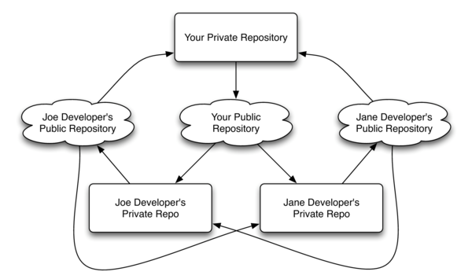
Recall what we have learned
Decentralized Repository Model
CS 441 Software Engineering

Slide 4
GIT Basics
History
  Developed by Linus Tornalds, the creator of Linux, in 2005.
  Keywords: performance, distributed, trust
Installation
  http://git-scm.com
Setting up
  git config --global user.name “Jack Smith” (specify your name)
  git config --global user.email jack@hotmail.com (specify email)
  git config --global core.editor emacs (specify the default editor)
  git help <verb> (get help)
CS 441 Software Engineering

Slide 5
GIT Highlights
Snapshots, Not Differences
  Most version control systems store a set of files and the changes made to each file over time.
  GIT saves the state of your project: every time you commit, GIT records (i.e. takes a picture of) all the files and stores a reference to that snapshot.
  If files have not changed, GIT stores just a link to the previous identical file it already stored.
CS 441 Software Engineering

Slide 6
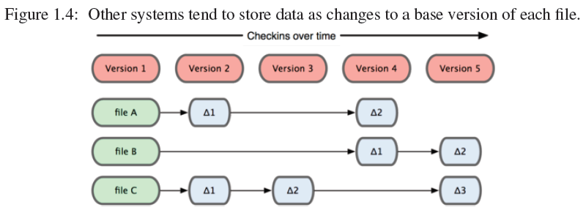
GIT Highlights
CS 441 Software Engineering

Slide 7
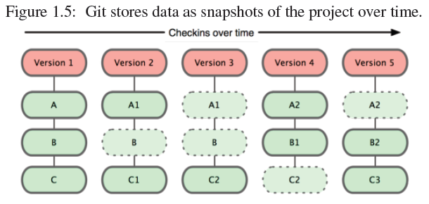
GIT Highlights
CS 441 Software Engineering

Slide 8
GIT Highlights
The Three States
  Committed: the data is safely stored in your local database.
  Modified: you have changed the file but have not committed it to your database yet.
  Staged: you have marked a modified file in its current version to go into your next commit snapshot.
The GIT directory: the object database for your project.
The working directory: a single checkout of one version of the project that is ready to be modified.
The staging area: a simple file that stores information about what will go into your next commit.
CS 441 Software Engineering

Slide 9
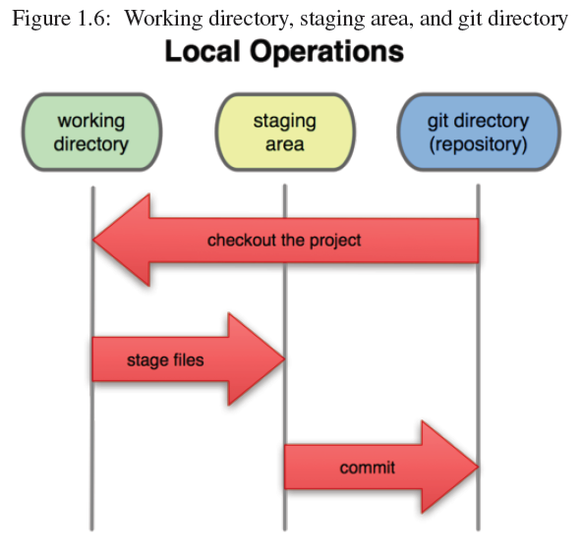
GIT Highlights
CS 441 Software Engineering

Slide 10
Working with the Private Repository
Creating a local repository
  Initializing a repository from an existing directory
  Cloning a remote repository
Making changes to the repository
  Tracking new files
  Staging modified files
  Committing changes
  checking the status
  Viewing the commit history
Undoing changes
CS 441 Software Engineering

Slide 11
Creating a local repository
Initializing a repository from an existing directory
  Go to the project’s directory and type git init.
  This creates a new subdirectory named .git – GIT directory.
Cloning a remote repository: git clone [url]
  Creates a new directory
  Initializes a .git directory in the new directory.
  Pulls down all the data from the repository.
  Checks out a working copy of the latest version.
  Add the repository to your remote server list (named ‘origin’).
  Automatically creates a master branch that tracks origin/master.
CS 441 Software Engineering

Slide 12
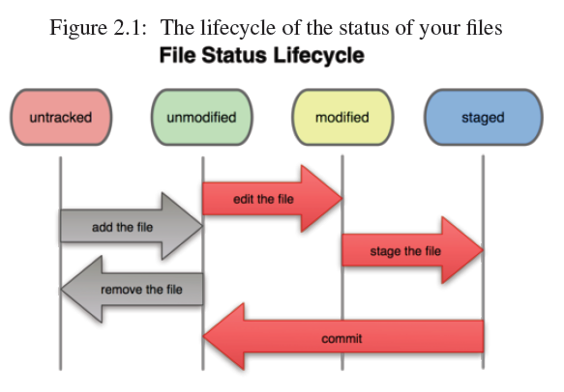
Making changes
CS 441 Software Engineering

Slide 13
Making changes
Tracking new files
  The change will be automatically staged.
    git add README (to begin tracking the README file)
Staging modified files
  After you change a file that was already tracked, you need to explicitly stage it into your next commit.
    git add benchmark (assuming that the benchmark file was tracked and modified)
About git add: a multipurpose command
  To begin tracking new files
  To stage files
  To mark merge-conflicted files as resolved
CS 441 Software Engineering

Slide 14
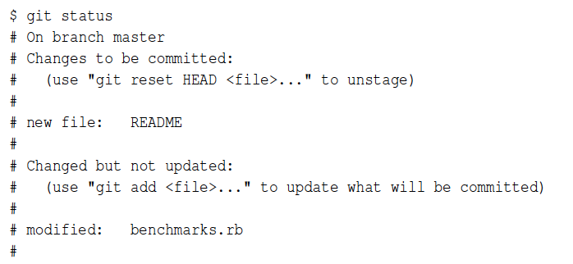
Making changes
Checking the status of working directory
  The git status command determines which files are in which state.
CS 441 Software Engineering

Slide 15
Making changes
Committing changes
  Only commit the staged changes.
    git commit –m “…”
  The commit command records the snapshot you set up in your staging area.
Viewing the commit history
  Use the git log command
  Many options are available, such as –p, -2, etc.
CS 441 Software Engineering

Slide 16
Undoing changes
Changing you last commit
  Overwrite the previous commit, and end up with a single commit.
    git commit --amend
Unstaging a staged file
  Cancel the changes made to the staging area.
    git reset HEAD <file>
    E.g. git reset HEAD benchmarks
Unmodifiying a modified file
  Cancel the working directory changes
    git checkout -- <file>
    E.g. git checkout -- benchmarks
CS 441 Software Engineering

Slide 17
Working with the Public Repository
Protocols of accessing remotes
Creating a repository on the server
Managing remotes
  Adding remote repositories
  Listing remotes
  Inspecting a remote
  Removing and renaming remotes
Fetching and pulling from remotes
Pushing to remotes
CS 441 Software Engineering

Slide 18
Protocols of accessing remotes
Local protocol: used when the remote repository is in another directory on disk.
  E.g. git clone file:///opt/git/project.git
The SSH protocol: the most common transport protocol of GIT.
  The only network-based protocol that you can write to.
  GIT servers authenticate using SSH public keys.
  E.g. git ssh://user@server:project.git
The GIT protocol
The HTTP/S protocol
CS 441 Software Engineering

Slide 19
Creating a repository on a server
Bare repository: a GIT repository that has no working directory.
Bare repository is the contents of your project’s .git subdirectory. This is your Git repository where all the data of your project snapshots are stored.
To create a repository from an existing directory of files, simply run git init --bare in that directory.
An SSH server and a bare repository are the only two things you need to collaborate with other people on a project.
CS 441 Software Engineering

Slide 20
Managing remotes
Adding remote repositories
  git remote add [shortname] [url]
  E.g. git remote add pb git://github.com/paulboone/ticgit.git
Listing remotes
  List remote servers that you have configured
  If you have cloned your repository, you should see at least “origin” – the default name GIT gives to the server you cloned from.
  git remote –v (the –v option includes the URL that GIT stored for the shortname)
CS 441 Software Engineering

Slide 21
Managing remotes
Inspecting a remote
  Shows more information about a particular remote, particularly about the branches.
    git remote show [remote-name]
Removing and renaming remotes
  Rename the name of a reference
    git remote rename [old-name] [new-name]
  Remove a remote
    git remote rm [remote-name]
CS 441 Software Engineering

Slide 22
Fetching and Pulling from Remotes
Fetching: git fetch [remote-name]
  Pulls down all the data from the remote project to your local repository.
  Get references to all the branches from that remote.
  Note: fetching does not make changes to your current working directory.
Pulling: git pull
  Running git pull fetches data from the server, and automatically tries to merge it into the code you are currently working on.
  Can be seen as running git fetch followed by git merge, which will be introduced later.
  Updates both local repository and working directory.
CS 441 Software Engineering

Slide 23
Pushing to Remotes
Pushing a local project to the remote (public) repository to share with other people
  The command: git push [remote] [branch]
  make your [branch] the new [branch] on the [remote]
  Requires write access to the remote server
  If your branch is already on the server, it will try to update it, if it is not, GIT will add it.
  May be rejected if someone else “pushed” to the server before you.
CS 441 Software Engineering

Slide 24
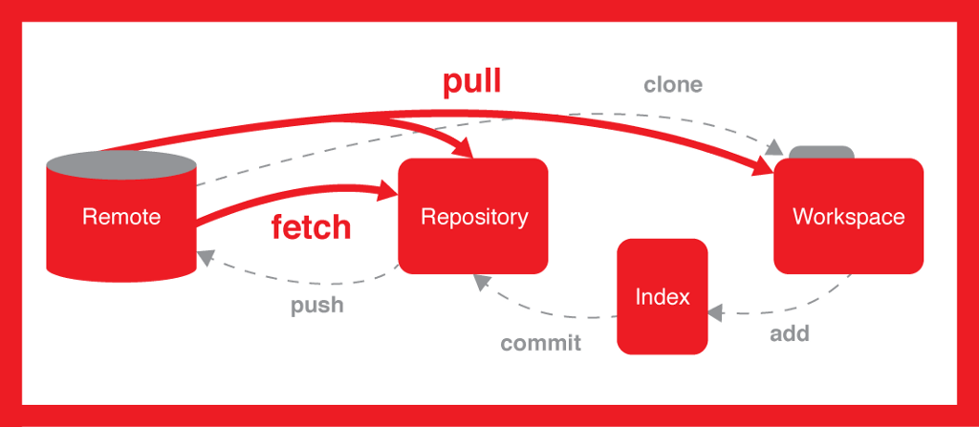
Source: https://medium.com/happyfresh-fleet-tracker/git-101-pushing-pulling-etc-67ea989f74e0
CS 441 Software Engineering

Slide 25
GIT Branching
Branches in GIT
Basic branching and merging
  Creating branches
  Switching between branches
  Basic Merging
Remote branches
  Tracking branches
CS 441 Software Engineering

Slide 26
Branches in GIT
When you commit in GIT, GIT stores a commit object that contains
  A pointer to the snapshot of the content you staged.
  The author and message metadata
  Zero or more pointers to the commit or commits that were the direct parents of this commit
    0 parents: first commit
    1 parent: a normal commit
    >1 parents: a commit resulting from a merge of two or more branches
A branch in GIT is simply a lightweight movable pointer to one of these commit.
Creating a new branch in GIT just creates a new pointer.
CS 441 Software Engineering

Slide 27
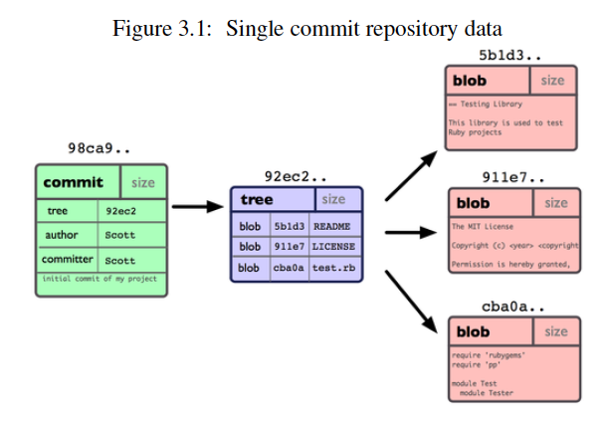
Branches in GIT
CS 441 Software Engineering

Slide 28
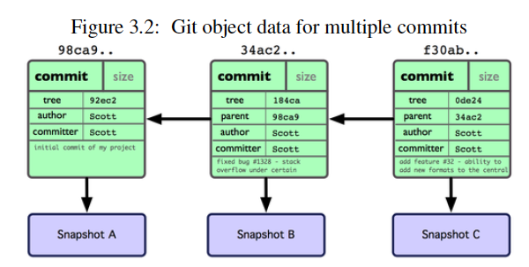
Branches in GIT
CS 441 Software Engineering

Slide 29
Basic Branching and Merging
Branch management
  git branch [name-of-the-new-branch] (Create a branch)
  git branch (List all the current branches)
  git branch –d [name-of-the-branch-to-delete] (Delete a branch)
Switching between branches
  git checkout [name-of-the-branch]
Creating a branch and switching to it at the same time
  git checkout –b [name-of-the-branch]
CS 441 Software Engineering

Slide 30
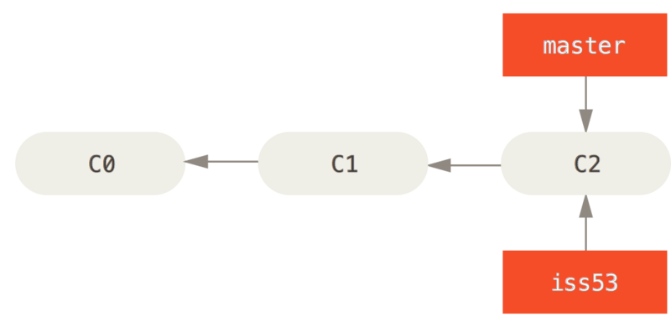
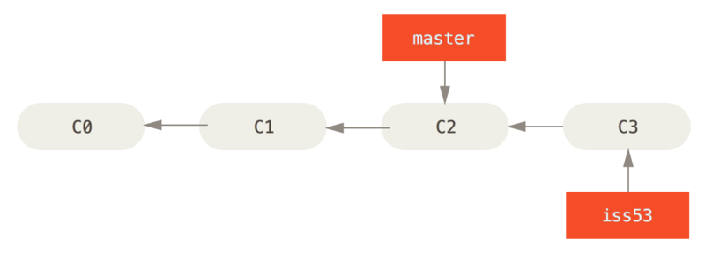
Basic Branching and Merging
To merge Branch A into Branch B
    Switch to Branch B: git checkout B
    Run the git merge command: git merge A
GIT fast forward merging
CS 441 Software Engineering

Slide 31
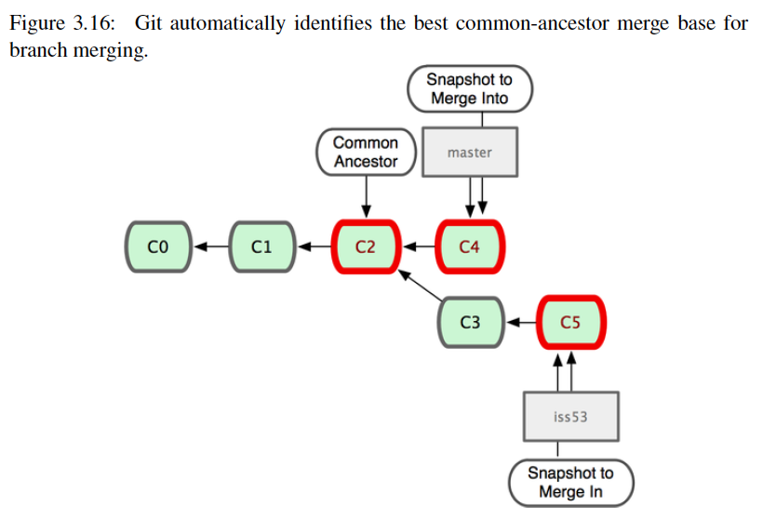
Basic Branching and Merging
GIT also uses a three-way merging mechanism that identifies the best common ancestor.
CS 441 Software Engineering

Slide 32
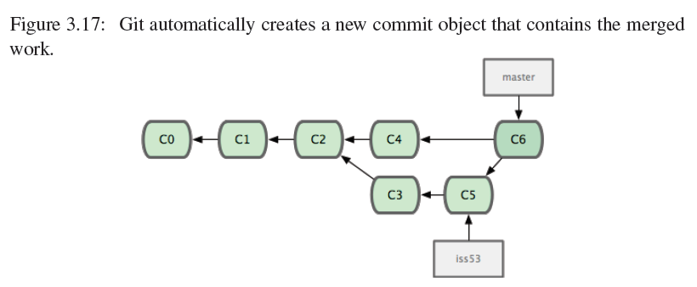
Basic Branching and Merging
As the result of merging, GIT creates a new snapshot and automatically creates a new commit that points to it.
CS 441 Software Engineering

Slide 33
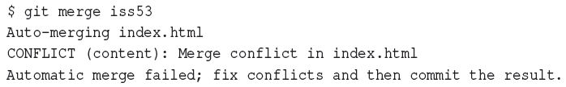
Basic Branching and Merging
Merge conflicts: the same part of the same file was changed differently in the two branches you are merging together.
Again, merge conflicts have to be manually resolved.
After you have resolved the conflicts, run git add on each conflicted file to mark it as resolved.
Run git commit to finalize merge.
CS 441 Software Engineering

Slide 34
Remote branches
Remote branches are references to the state of branches on your remote repositories.
They take the form (remote)/(branch)
  E.g. origin/master
Pushing a branch to the server.
  git push (remote) (branch)
  E.g. git push origin serverfix:adifferentname
Merging a remote branch
  git merge origin/serverfix
CS 441 Software Engineering

Slide 35
Remote branches
Tracking branches: checking out a local branch from a remote branch automatically creates what is called a tracking branch.
  git checkout –b serverfix origin/serverfix
Tracking branches are local branches that have a direct relationship to a remote branch.
  If you are on a tracking branch and type git push, GIT automatically knows which server and branch to push to.
  Similarly, running git pull while on one of these branches fetches all the remote references and then automatically merges in the corresponding branch.
CS 441 Software Engineering

Slide 36
GIT Working Flow
Having several branches open at the same time, with each used for different stages of your development cycle.
Centralized workflow
  All peers share the same public (remote) repository.
Integration-Manager Workflow
  There are multiple remote repositories.
  Each developer has write access to their own public repository, and read access to everyone else’s.
  This scenario often includes a canonical repository that represents the “official project”.
CS 441 Software Engineering

Slide 37
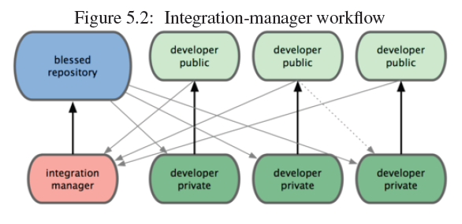
GIT Working Flow
CS 441 Software Engineering

Slide 38
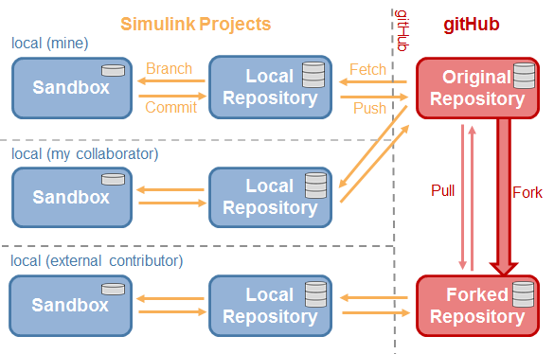
Using GitHub to Collaborate
Source: https://blogs.mathworks.com/simulink/2014/04/17/social-collaboration-using-git-for-model-based-design/

Slide 39
Two different ways to collaborate …
Repository Owner and Collaborator (recommended)
  The entire team shares the same (public) repository created by team lead (i.e., Repository Owner) in GitHub.
  Each team member is a collaborator that maintains a local copy of the repository (e.g., by cloning from the shared repository).
  Each team member can push his/her local changes to the shared repository.
  Alternatively, each team member can work on a branch created in the repository.
Fork and Pull Request
  Used to manage two separate public repositories in GitHub.
  This is a feature developed in GitHub (not Git).

Slide 40
Common Questions and Answers
When should I clone versus fork a repository?
  Use clone to create a local repository from a public repository.
  Use fork to create a second public repository.
How often should I commit?
  As often as you can (without breaking the build).
What to do when there’s a conflict?
  Pull, review, modify, commit merge, and push.
When should I start a new branch?
  To implement a new feature, do an experiment, test, etc.
How do I merge a branch back to the Master?
  Switch to the Master branch first and go to Branch-> Merge into Current Branch …

Slide 41
Reference
All the diagrams of this lecture are from the book “Pro Git” by Scott Chacon.
CS 441 Software Engineering

